Slide 2
What is DEHR?
It began with a DEHR Committee at the provincial ATA level
Now almost every ATA Local has its own DEHR Committee
Each DEHR Committee’s mandate is to promote Diversity, Equity, and Human Rights in our schools and communities

Slide 3
What is DEHR to Care?
DEHR to Care is an Art Gala event that we have been hosting for the past three years!
This year will mark our FOURTH annual DEHR to Care Gala!
Each year, the Gala has a different theme. It raises funds and awareness for multiple causes.

Slide 4
What is DEHR to Care? (continued)
This year’s theme is “Diverse Relationships”, which we will talk more about later on!
Hundreds of local students are invited to explore the theme and create art pieces. These art pieces are displayed and sold at our Gala event.

Slide 5
Looking back to previous DEHR to Care art galas….

Slide 6
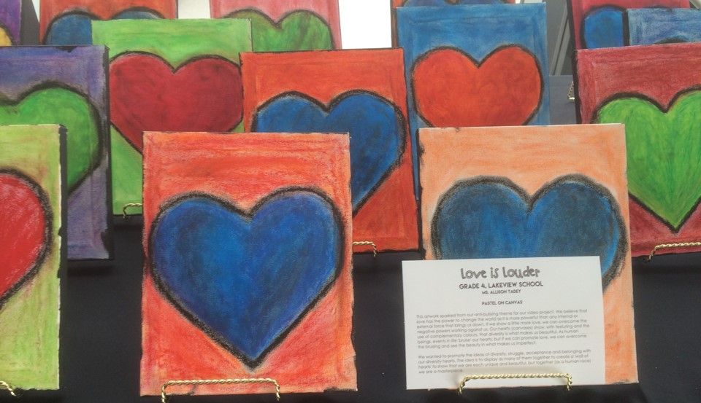
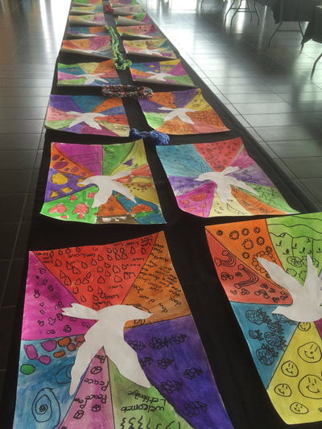
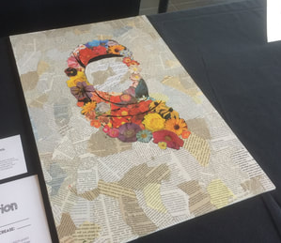
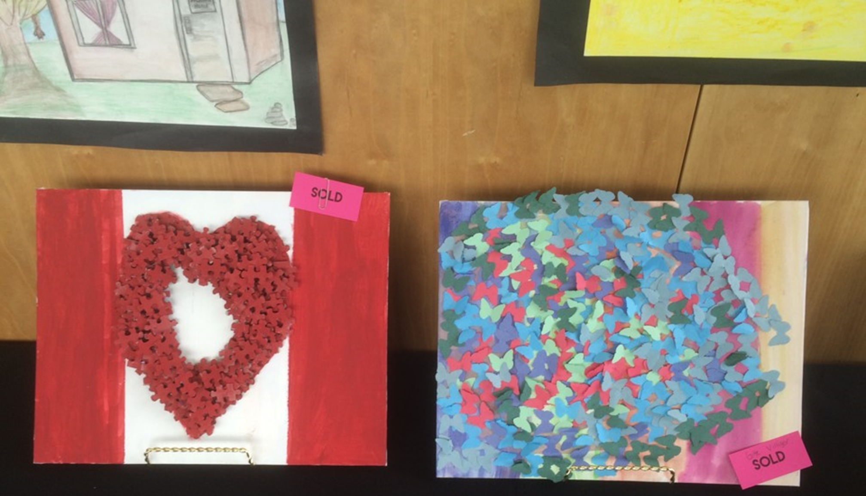
2016
Focus:
Supporting the Lethbridge Family Service’s Refugee Fund.

Slide 7
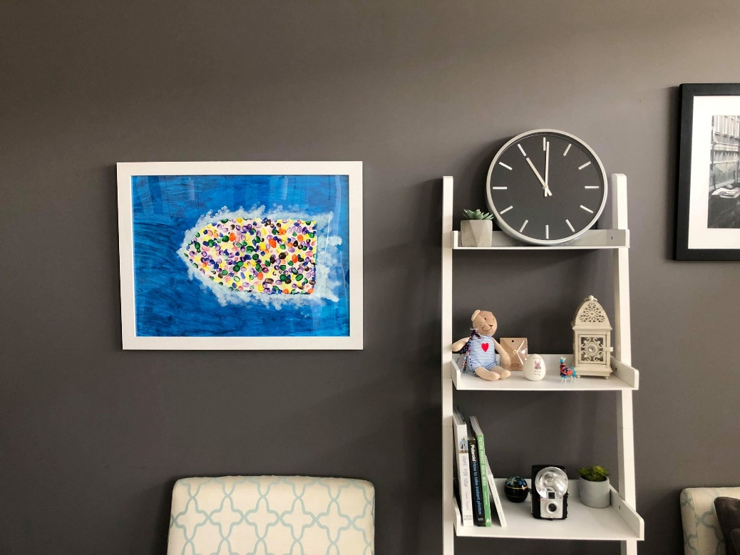
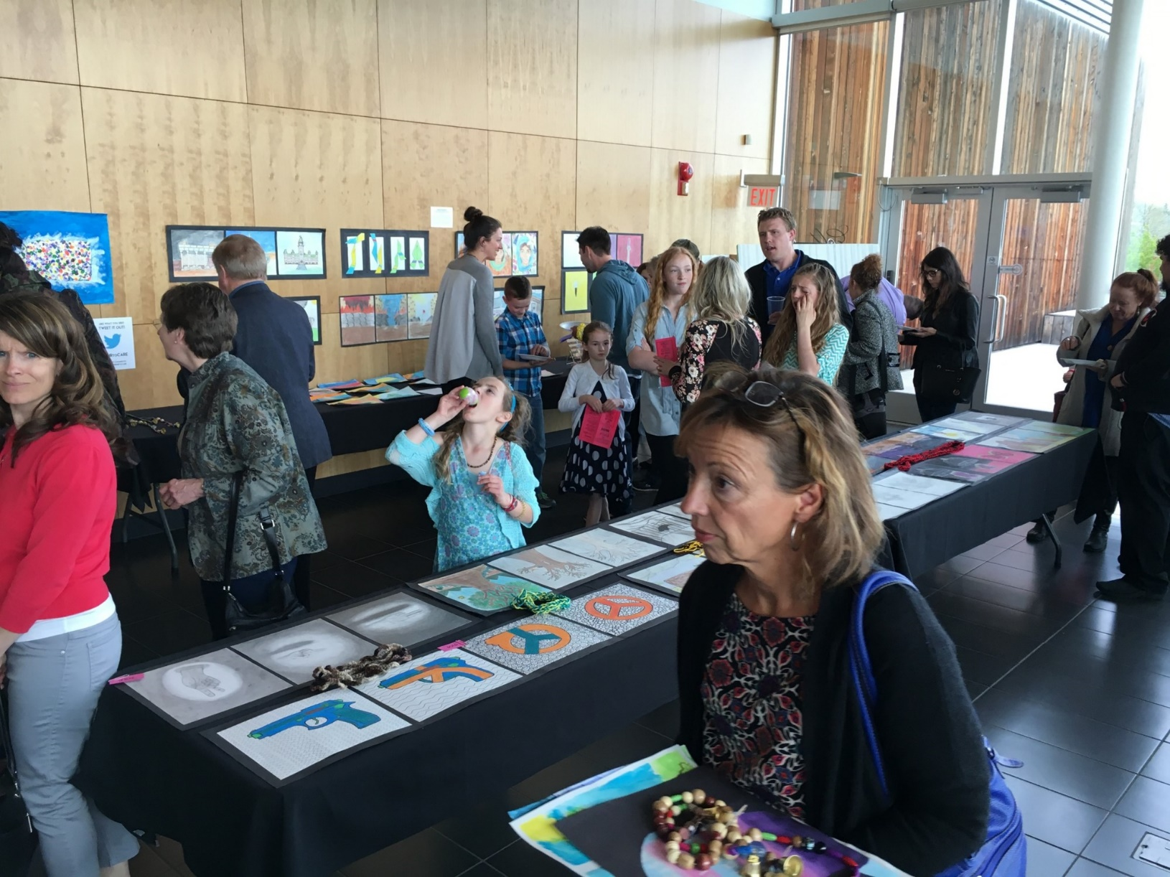
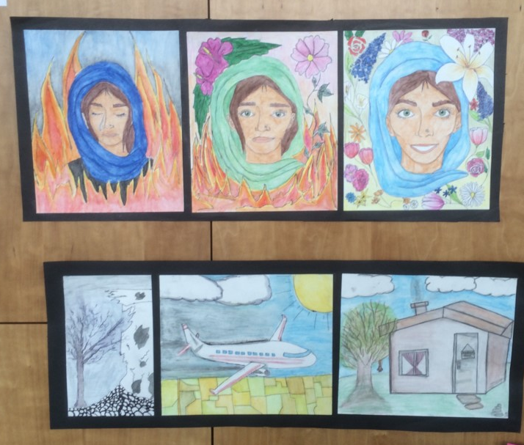
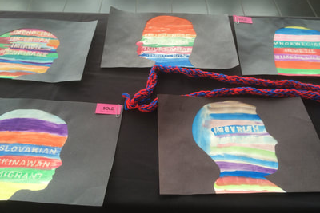
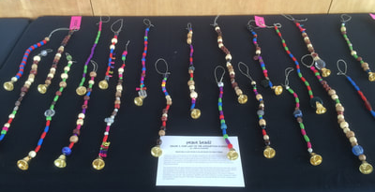
2016

Slide 8
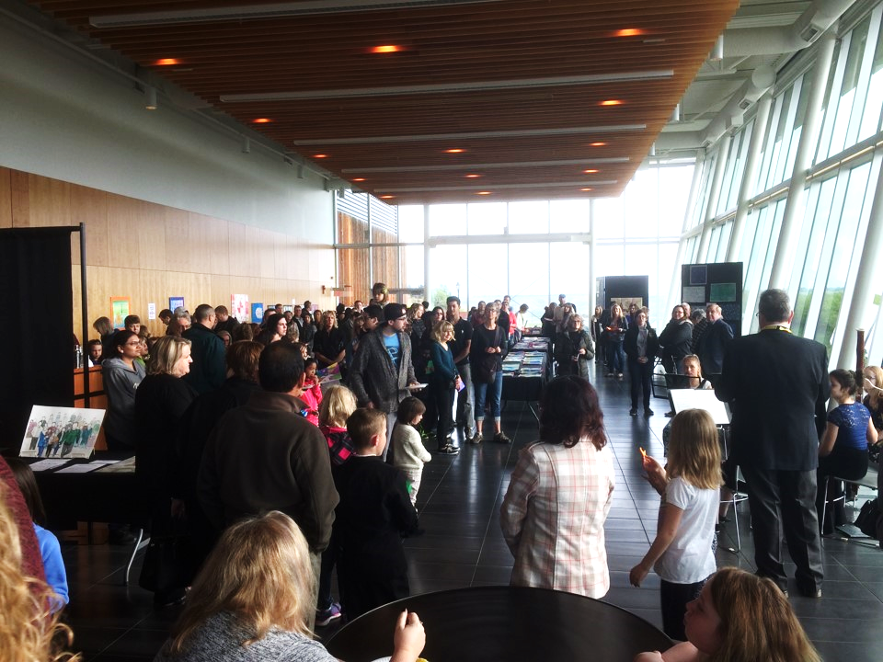
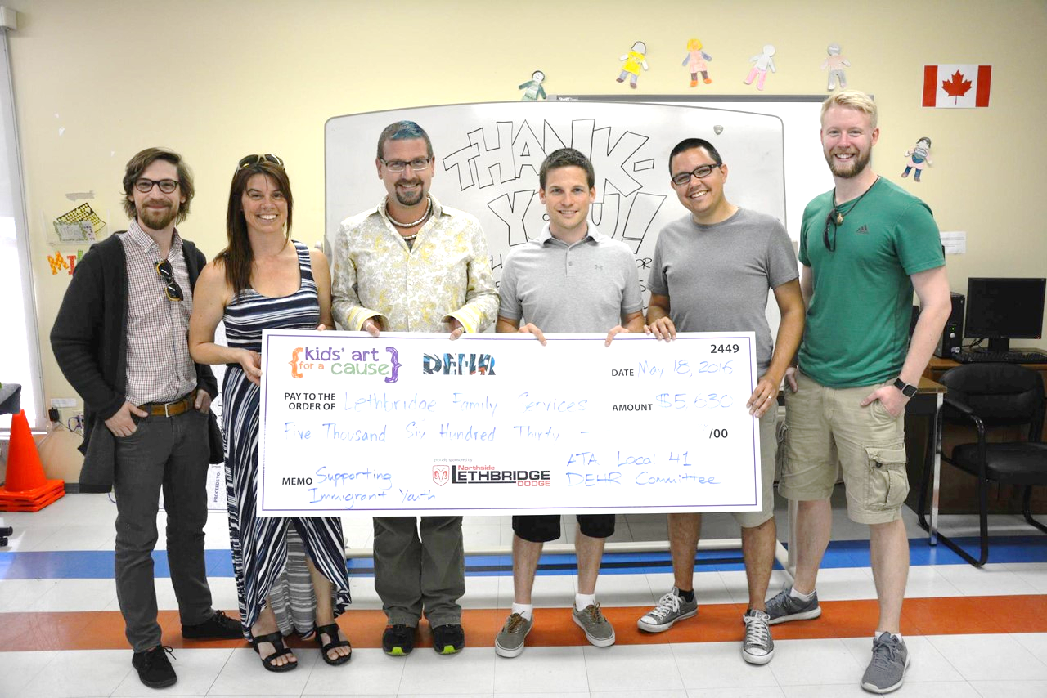
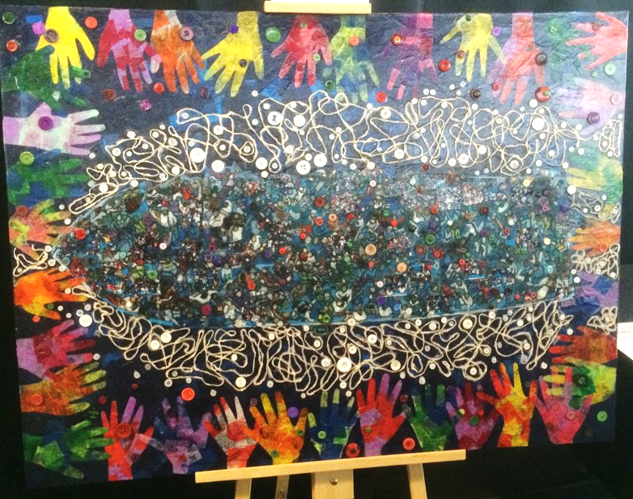
2016

Slide 9
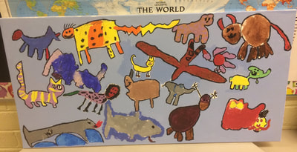
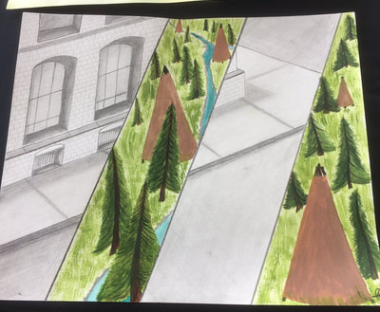
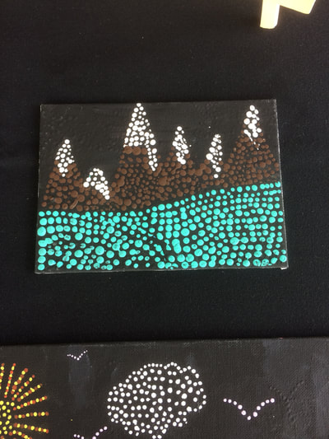
2017
Focus:
“Becoming the Canada We Want to Be”, and proceeds went to provide opportunities for children from FNMI backgrounds.

Slide 10
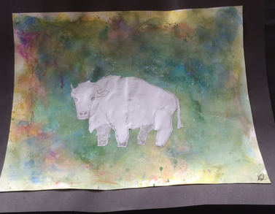
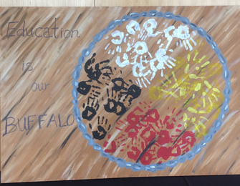
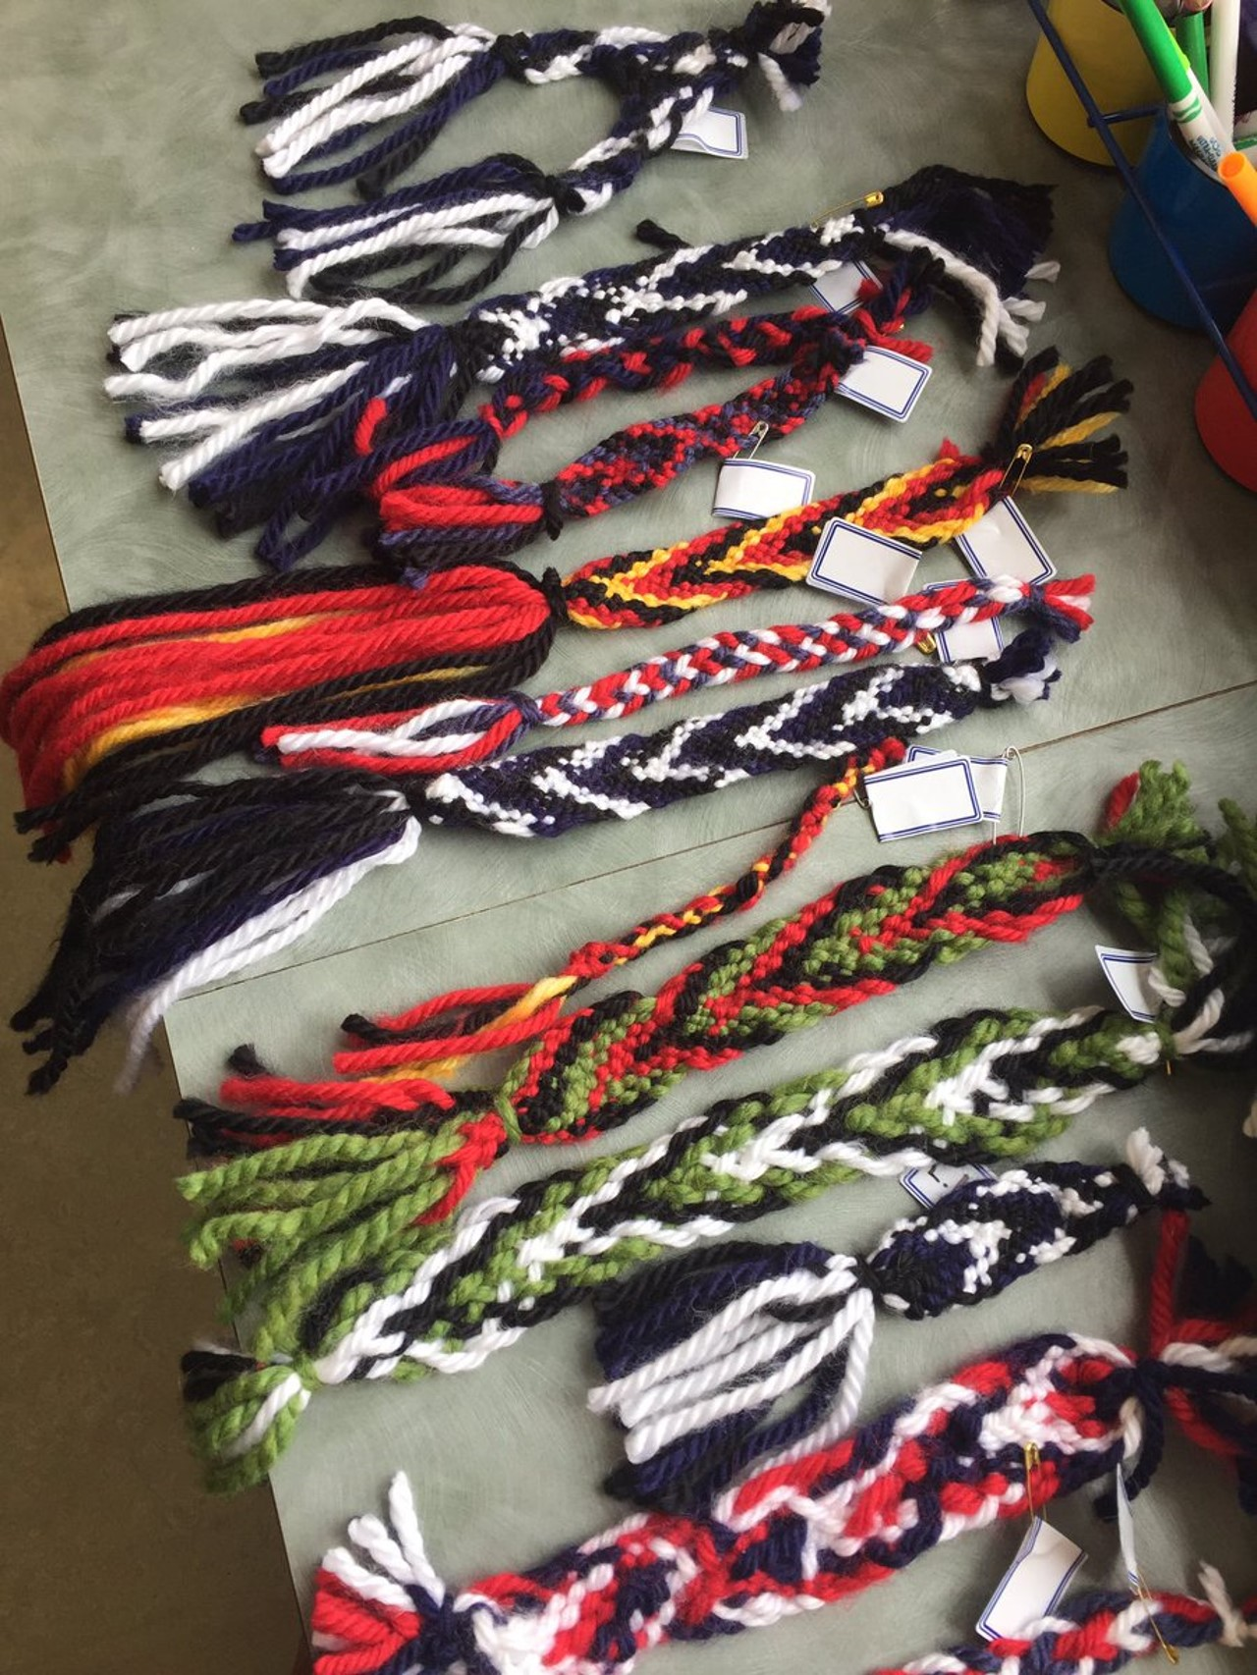
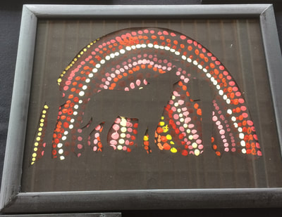
2017

Slide 11
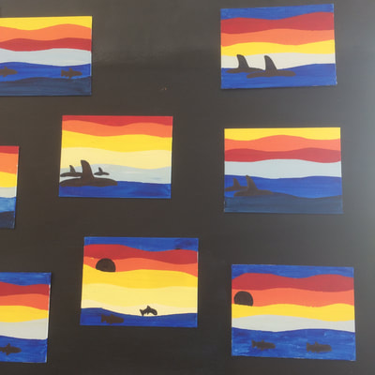
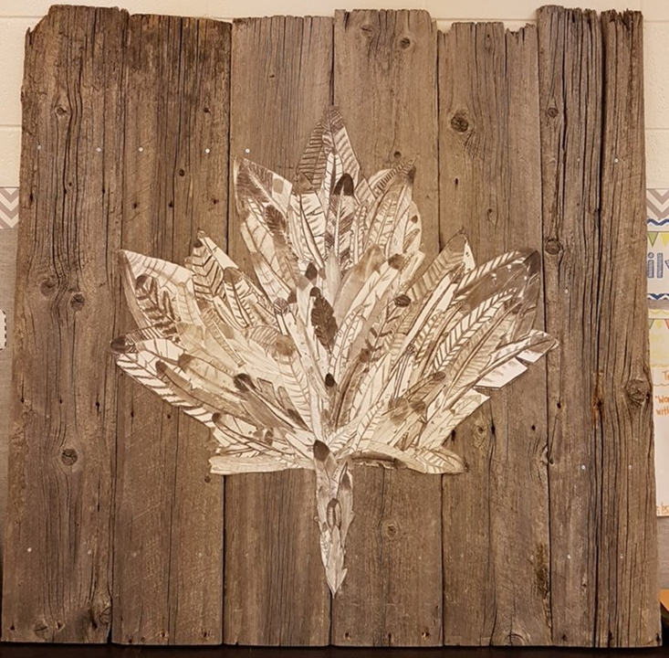
2017

Slide 12
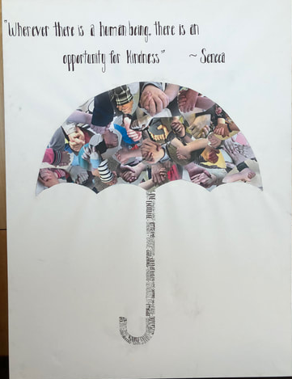
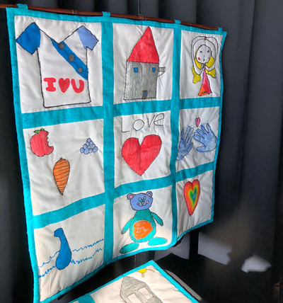
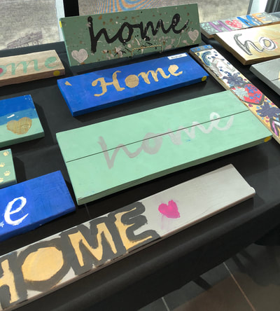
2018
Focus:
Youth homelessness, and proceeds went to the McMan Youth Hub.

Slide 13
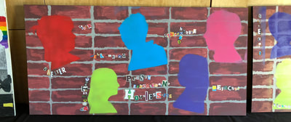
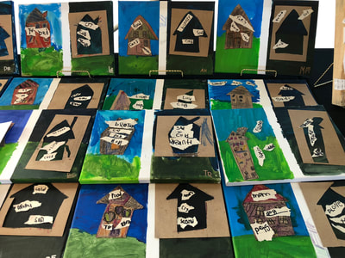
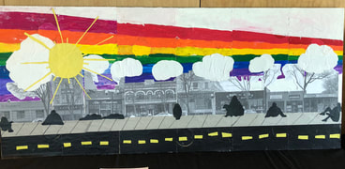
2018

Slide 14
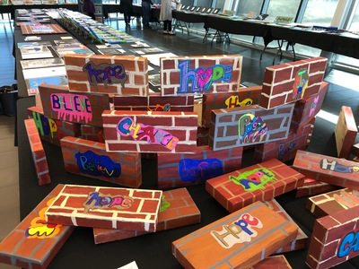
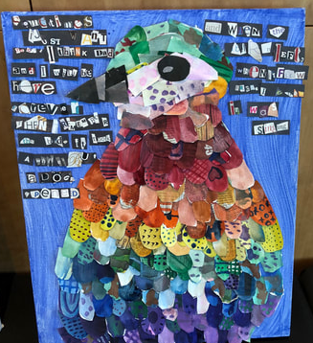
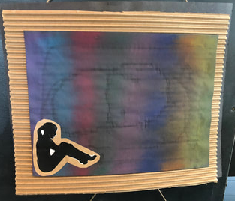

Slide 16
Why focus on ‘Diverse Relationships’?
“Relationships are powerful. Our one-to-one connections with each other are the foundation for change. And building relationships with people from different cultures, [and walks of life]…is key in building diverse communities that are powerful enough to achieve significant goals.” – Community Tool Box

Slide 17
Why focus on ‘Diverse Relationships’? (continued)
We chose “Diverse Relationships” as our focus this year, because it is becoming increasingly more important to rally together and build loving and accepting connections with one another
We want to highlight the beauty that exists in diversity, and the connections that are made between people of different mindsets and backgrounds

Slide 18
Why focus on ‘Diverse Relationships’? (continued)
Our topic is intentionally broad. We want all grade levels to be able to interact with our message of diverse connection, in a way that is meaningful to them
Our students are on the front lines when it comes to being agents of change, and we often see beautiful reminders from the youngest members of our society about how to love one another, no matter our differences

Slide 19
Why focus on ‘Diverse Relationships’? (continued)
As an educator, you can choose the lens you would like to focus on our topic with.
Keep in mind, that ‘relationships’ do not have to be romantic. They may include friendships, families, community, daily interactions, etc.

Slide 20
Why focus on ‘Diverse Relationships’? (continued)
Some topics you may wish to explore with your students are as follows:
Intercultural relationships
LGBTQ+ relationships
Diverse families
If you find a different topic that works for you, we encourage you to follow that!

Slide 21
Why focus on ‘Diverse Relationships’? (continued)
We want to share a message of love and acceptance, while honoring the struggles that many minorities have faced over time
Please recognize that specific topics chosen may be triggering for some students. It is our duty as educators to ensure that all of our students are supported throughout our learning. If you are unsure of how to best support a student who may be having a difficult time with this theme, we encourage you to reach out to your school-based counseling team for support

Slide 22
Teaching Points
Relationship: the way in which two or more concepts, objects, or people are connected, or the state of being connected
We want to foster and celebrate strong relationships that exist within our world
These relationships may be romantic, friendly, familial, or simply day to day interactions
When we are connected, we all feel less alone
Helping students understand WHY connection is important, can improve their willingness to connect, and help celebrate the connections that already exist

Slide 23
Statistics
Canada is a beautiful melting pot of many different cultures. With these differences, comes the importance of acceptance and understanding. Encouraging and helping our students to learn more about the many cultures that make up Canada's population can be an important start!
The next couple slides will reference some statistics regarding Canada's diverse population, and can serve as teaching and discussion points within your classroom!

Slide 24
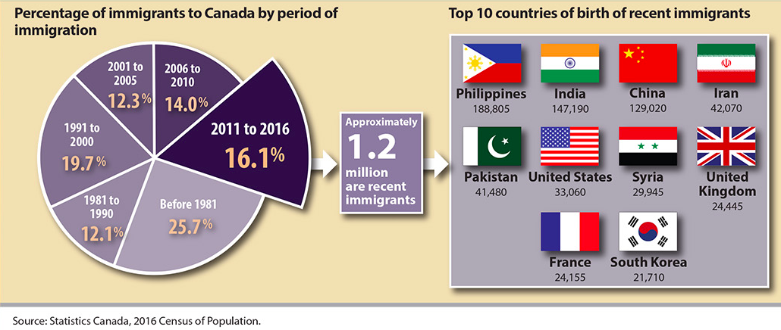
Statistics
1 out of 5 people in Canada’s population is foreign born (data from the 2011 National Household Survey)

Slide 25
Statistics
There were over 200 ethnic origins within Canada, as reported in the 2011 National Household Survey
The vast majority of foreign-born populations live in four provinces, Alberta being one of those
Among the G8 Countries, Canada has the highest proportion of foreign-born population

Slide 26
Statistics
We will have more district-specific cultural diversity information available on our website in the coming week!
An exciting addition to our theme, is the fact that Lethbridge District 51 will be embarking upon 1 District 1 Book, which will be set to finish right before the Gala begins!
The book chosen for 1D1B reflects the values that we want to encourage in our art and discussions around our art, and will add some excellent talking points within your classroom!

Slide 27
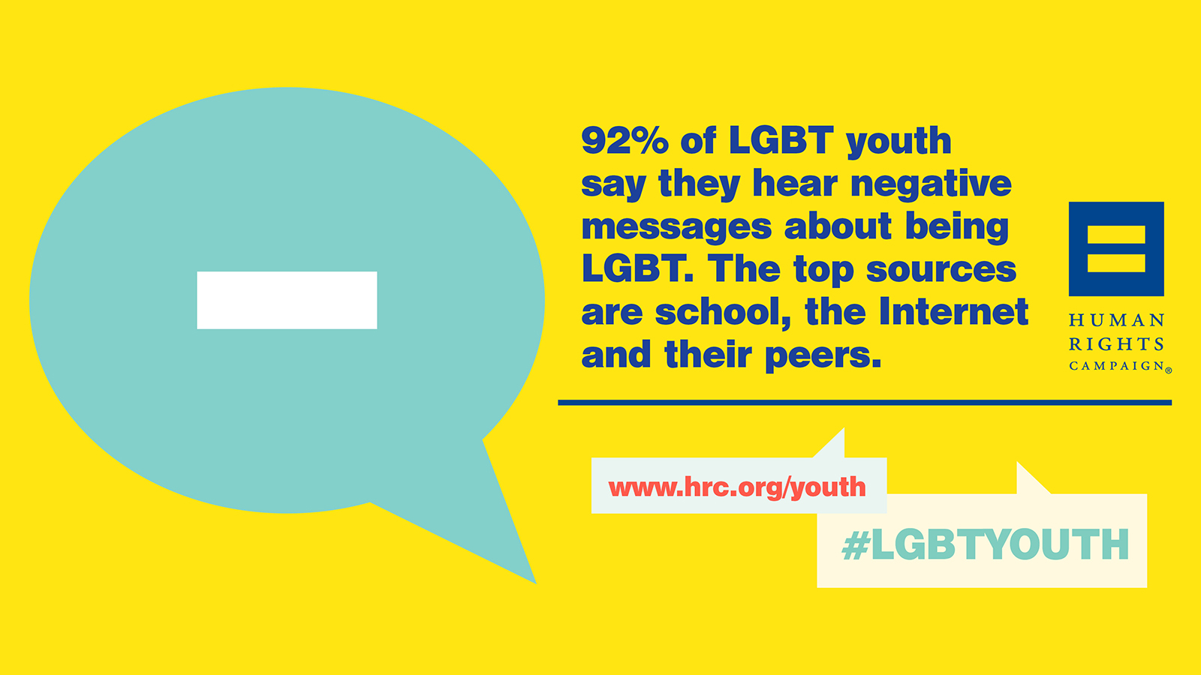
Teaching Points (continued)
Why are we focusing on LGBTQ+ individuals and the relationships that surround them?
Many LGBTQ+ individuals have been excluded in our culture because of perceived differences
This exclusion leads to disconnection. We need to help stop the cycle of misunderstanding and disconnection because:
Youth who are lesbian, gay, bisexual or questioning their sexual orientation are 3.4 times more likely to report a suicide attempt
Students, harassed based on actual or perceived sexual orientation, are more than three times as likely as students who are not harassed, to make a suicide attempt

Slide 28
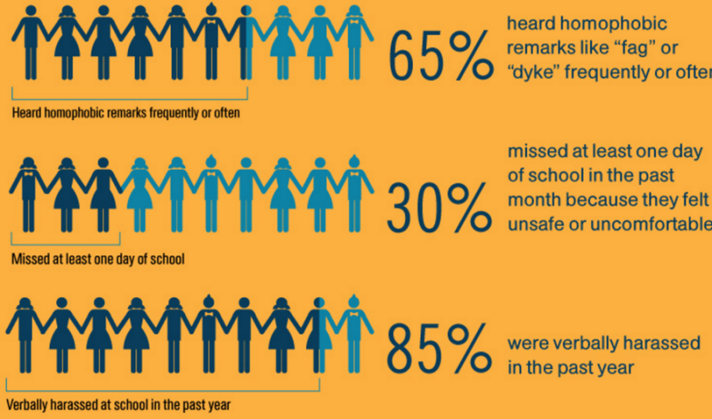
Teaching Points (continued)
Over one third (37.8%) of LGBTQ2S+ students have experienced some form of physical harassment (i.e., being pushed, punched, or spat upon)
Students, harassed because of their sexual orientation, were three times more likely than those who had never been harassed, to miss at least one day of school in the past month because they felt unsafe
Students, harassed because of their gender expression were twice as likely as those that had never been harassed, to have missed at least one day of school in the past month

Slide 29
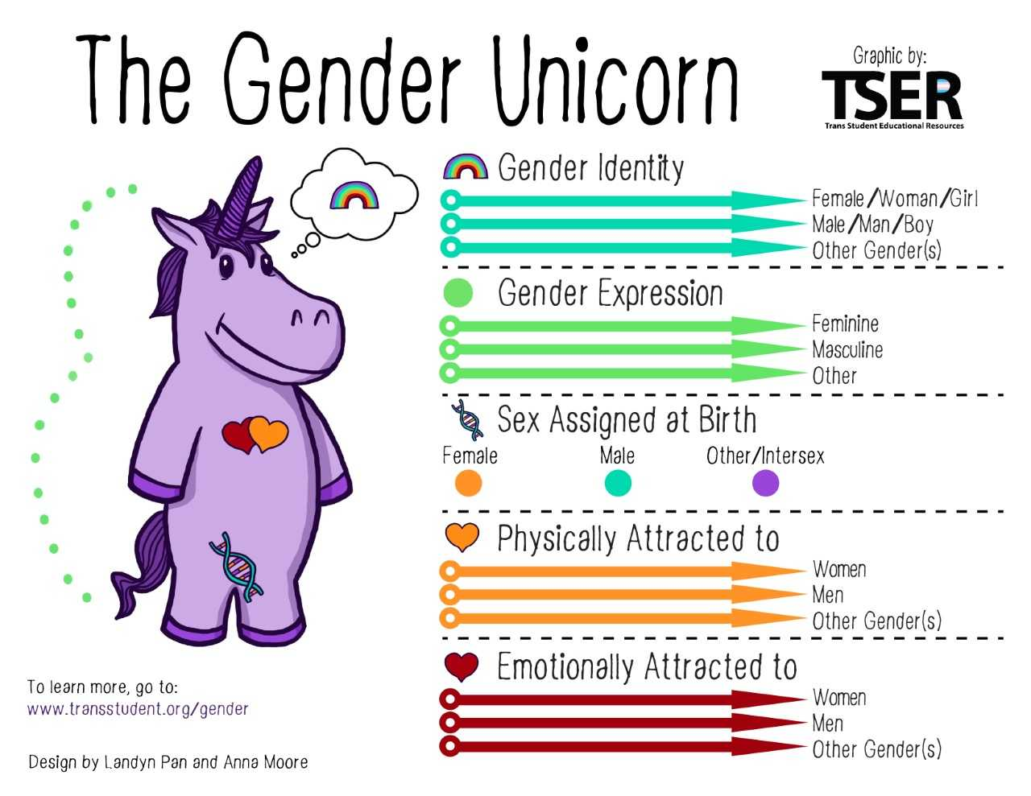
As a Classroom Teacher, How Can I Help???
Become familiar with the PRISM Materials provided by the ATA, as well as the best practices document.
Provide materials that are LGBTQ2S+ themed. Students, particularly those in their tween and teen years, say they want to see more genres featuring LGBTQ2S+ students as characters, even if (sometimes particularly if) gender identification or sexual orientation isn’t the main plot point.
Make certain that books with LGBTQ2S+ characters/themes are easily accessible to all.

Slide 30
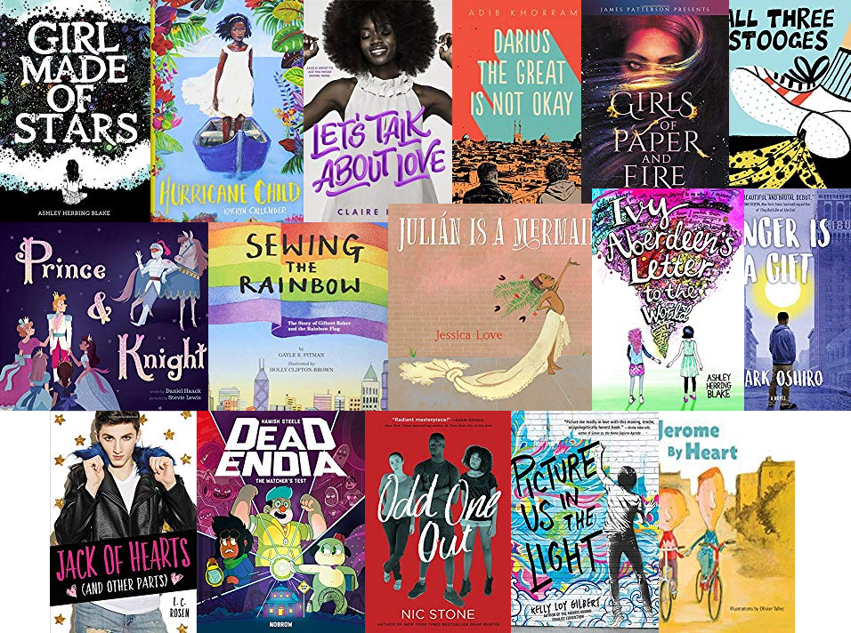
As a Classroom Teacher, How Can I Help? (continued)
Include LGBTQ2S+ themed books or authors in book talks.
Work collaboratively with colleagues on lessons or projects that address respect and appreciation for diversity.
Display books and hang posters with diverse faces and families.
Intervene when you see/hear name-calling or bullying in-person or online.

Slide 31
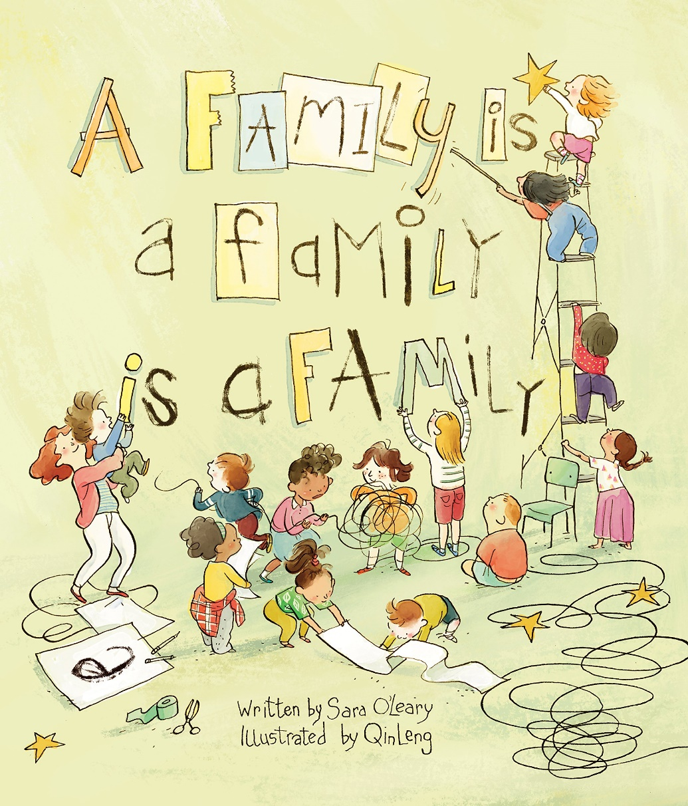
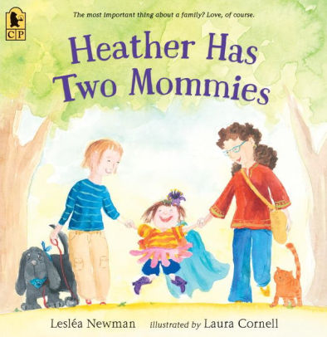
Book recommendations for elementary students:

Slide 32
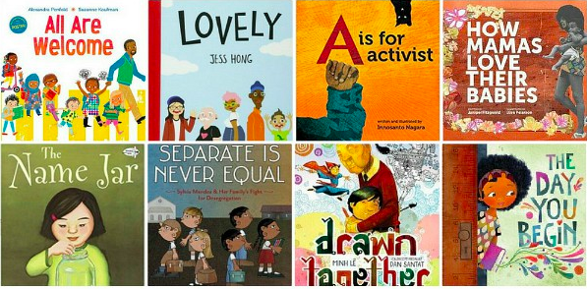

Slide 33
Book recommendations for middle school students:

